Slide 1
Disaster Preparedness:
The Basics
Presented by the Seattle Office of Emergency Management

Slide 2
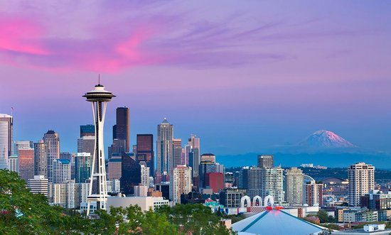
Seattle is vulnerable to many disasters…

Slide 3
Seattle’s top hazards…
Earthquakes
Snow and Ice Storms
Windstorms
Power Outages
Cyber Attacks
Landslides
Disease Outbreaks
Flooding
Excessive Heat
10. Tsunamis/Seiches
11. Infrastructure and Structural Failures
12. Fires
13. Transportation Incidents
14. Water Shortages
15. Social Unrest
16. Attacks
17. Hazmat Incidents
18. Volcanic Hazards

Slide 4
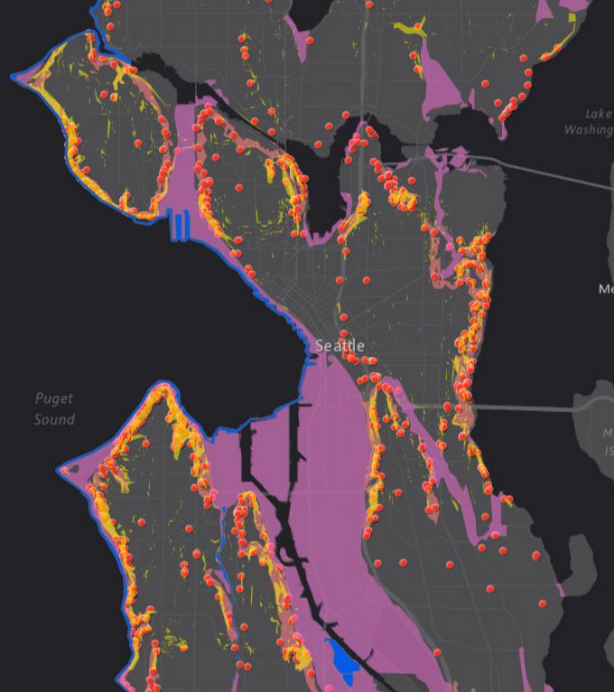
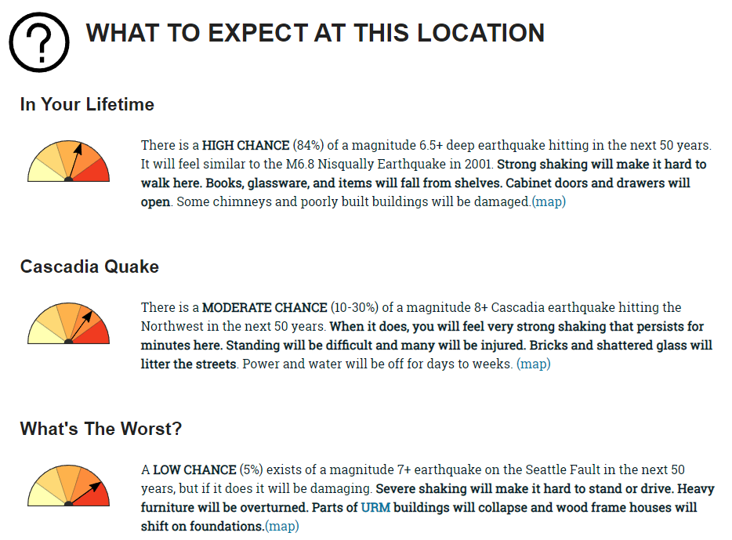
Seattle Hazard Explorer & King County Ready Tool
www.seattle.gov/hazardexplorer
www.hazardready.org/seattle

Slide 5
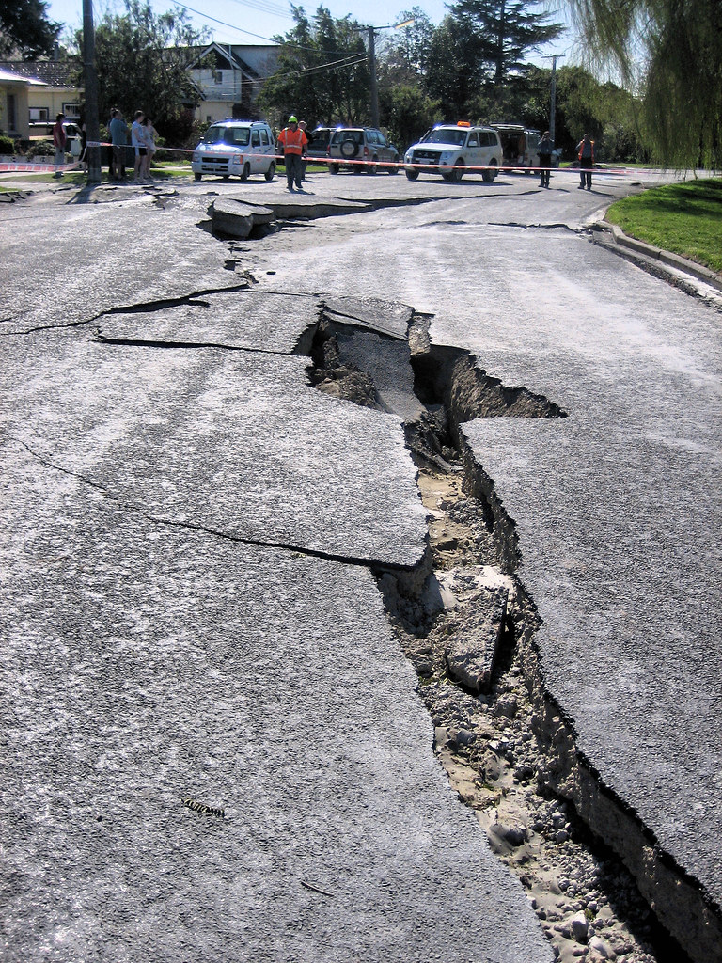

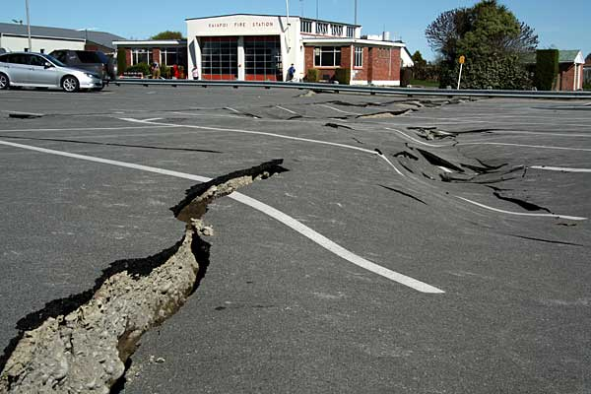
Know the reality
The services you rely on will be significantly disrupted.
People may not be able to get places easily (roads, bridges damaged, transit will stop)

Slide 6
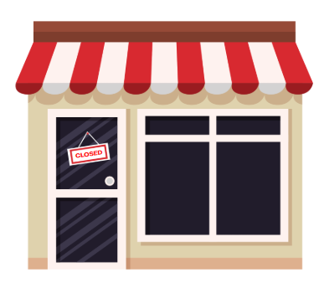
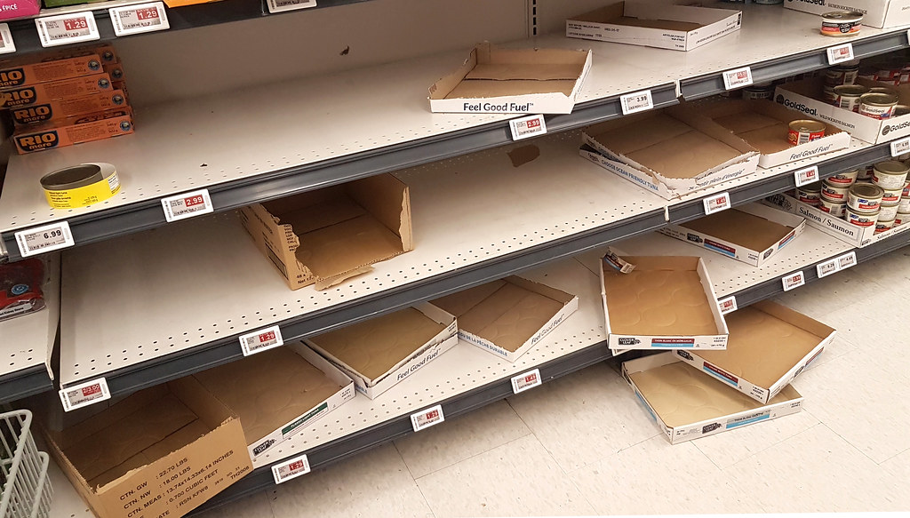
Know the reality
The services you rely on will be significantly disrupted.
Stores may quickly run out of supplies or normal places of business may close

Slide 7
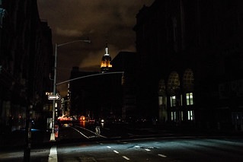
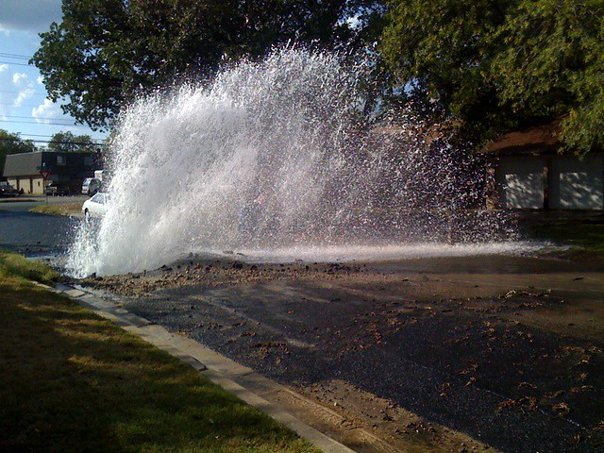

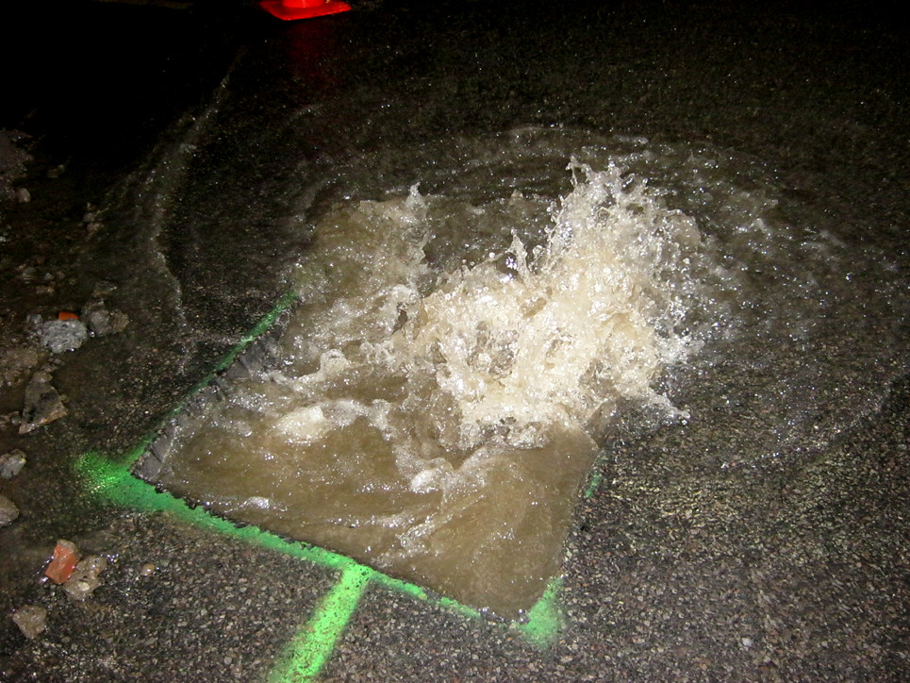
Know the reality
The services you rely on will be significantly disrupted.
Utilities may be damaged (electricity, water, sewer)

Slide 8

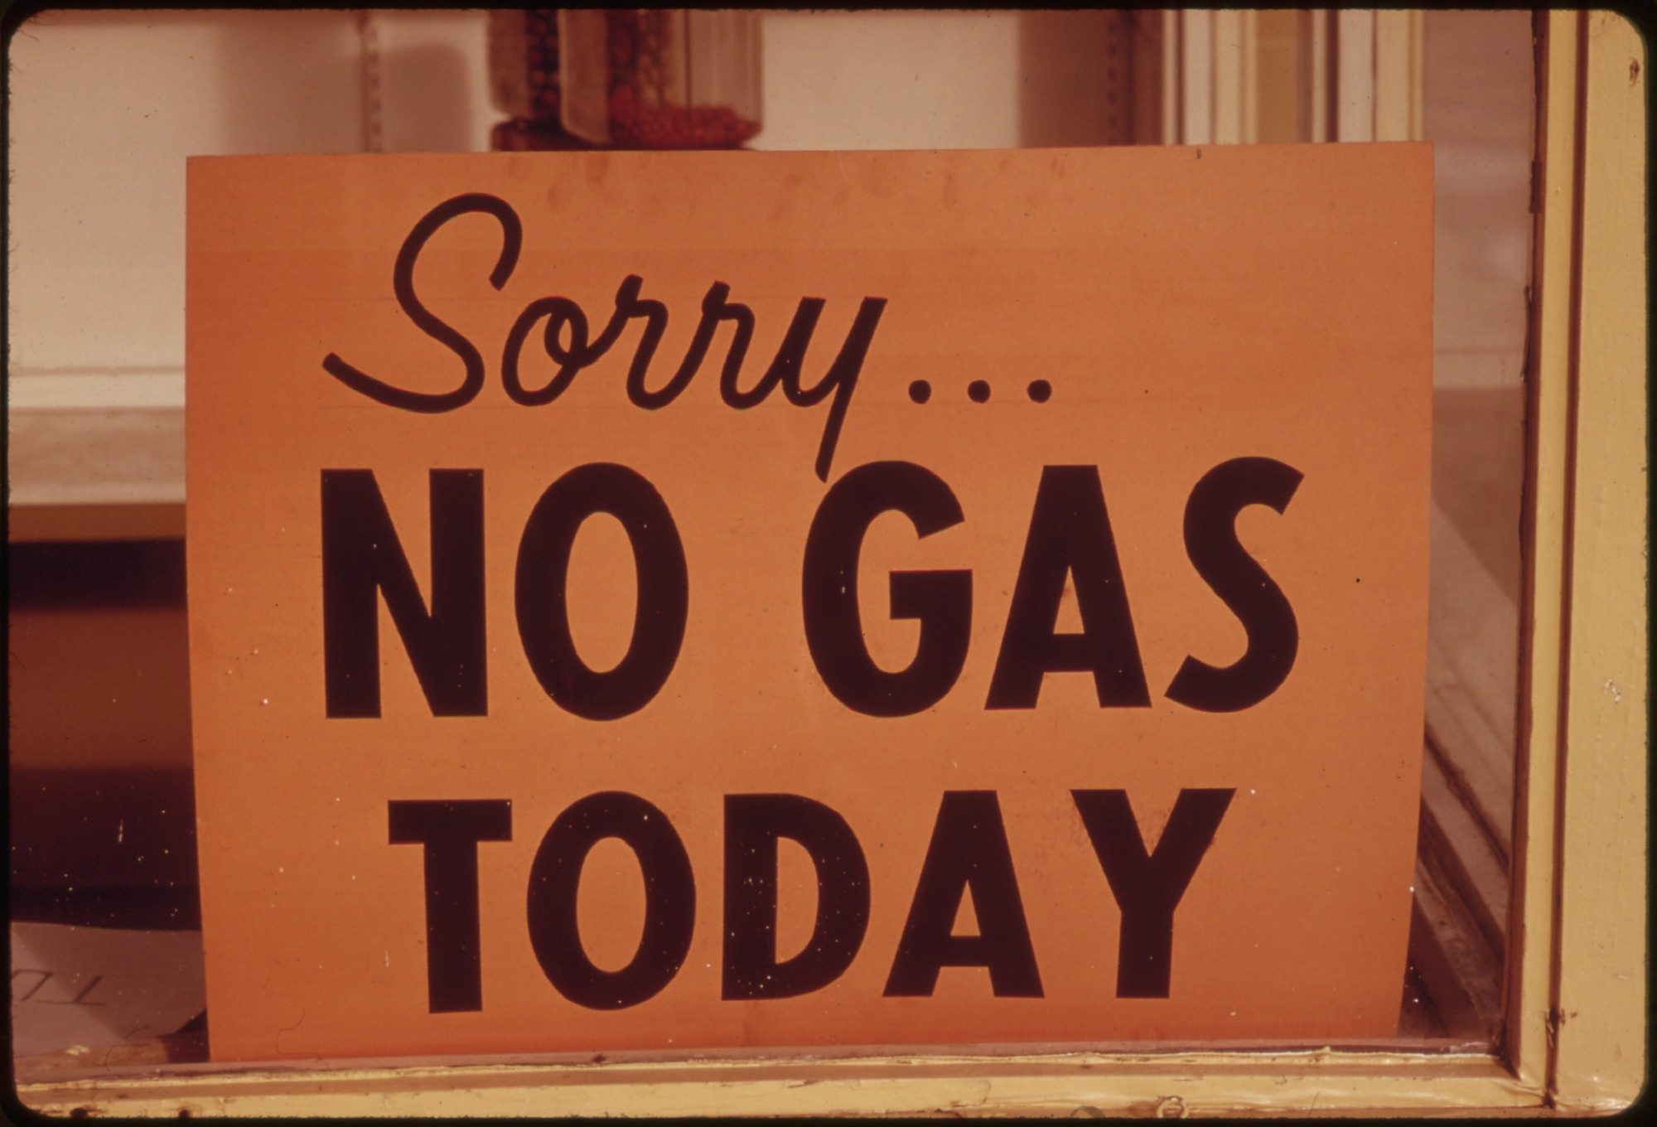
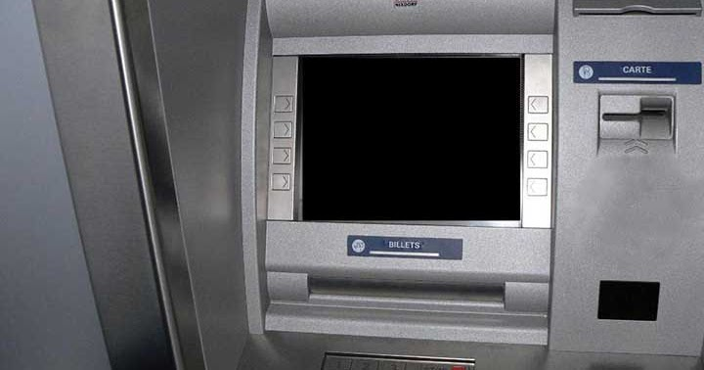
Know the reality
The services you rely on will be significantly disrupted.
Gas stations and ATM machines may not work

Slide 9

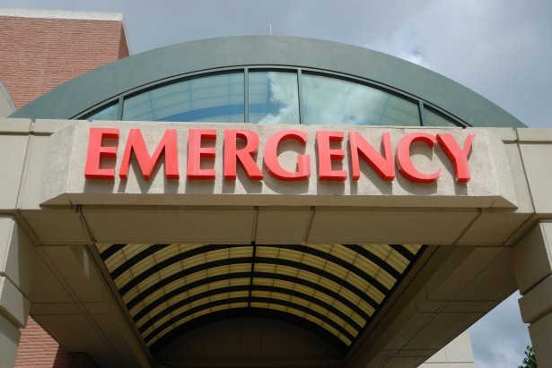
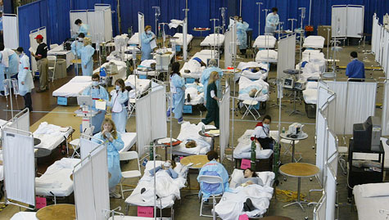
Know the reality
The services you rely on will be significantly disrupted.
Hospitals may be overwhelmed

Slide 10


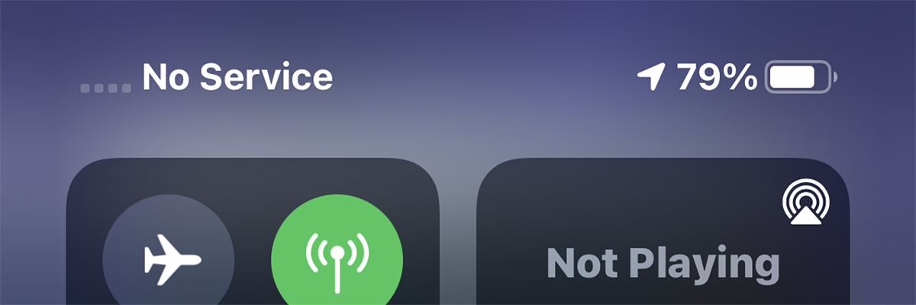
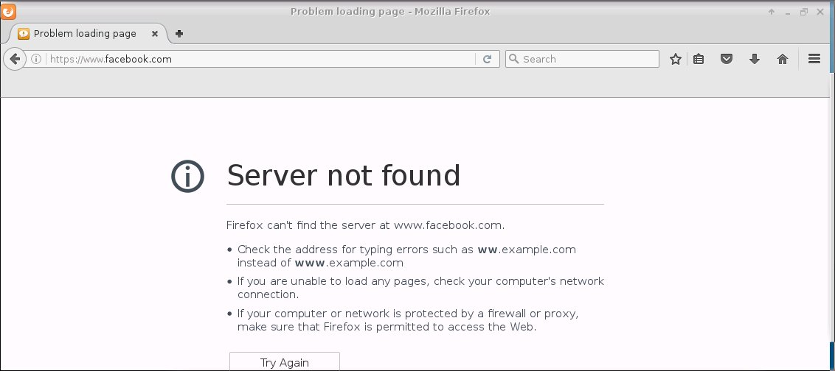
Know the reality
The services you rely on will be significantly disrupted.
Phones, cable TV, and internet may not work, or you may need to rely on new methods of communication to stay connected with friends and family

Slide 11
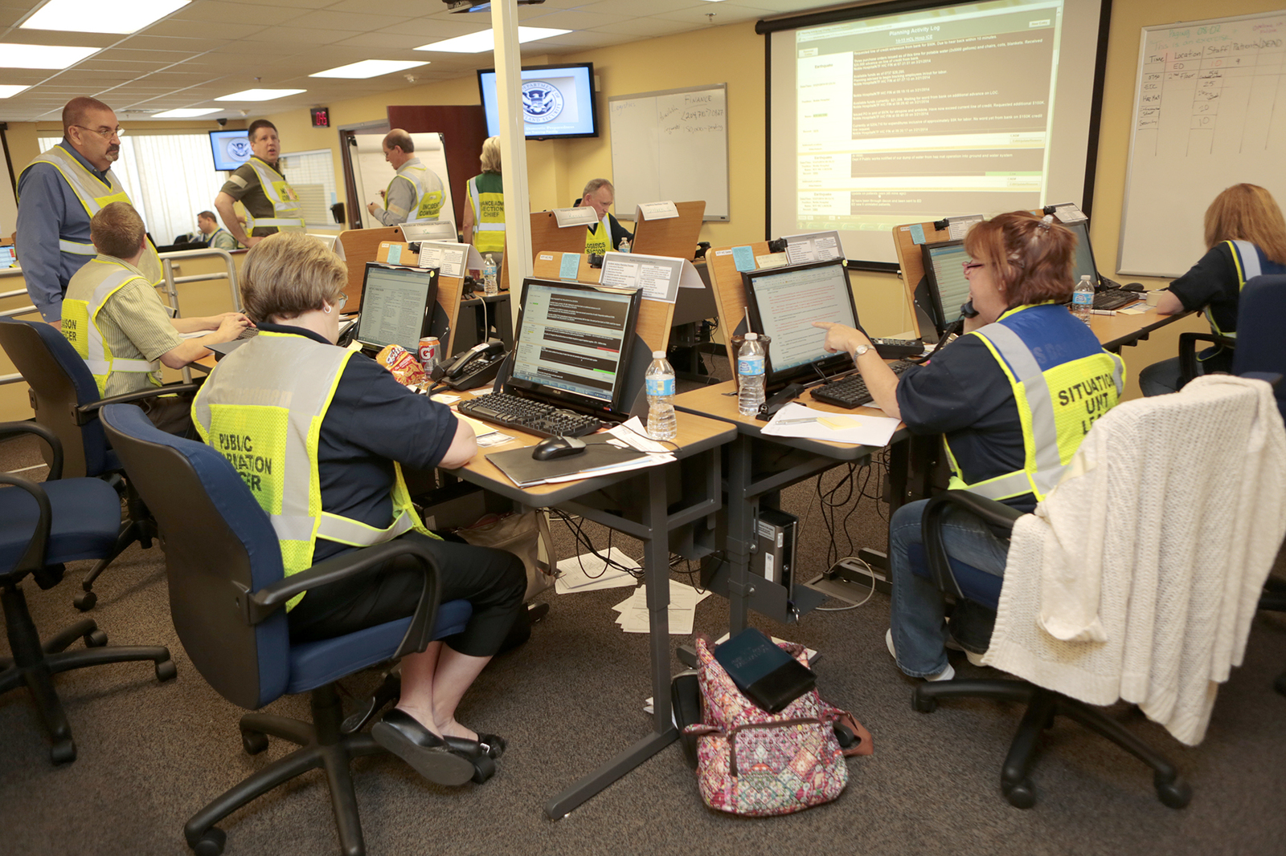
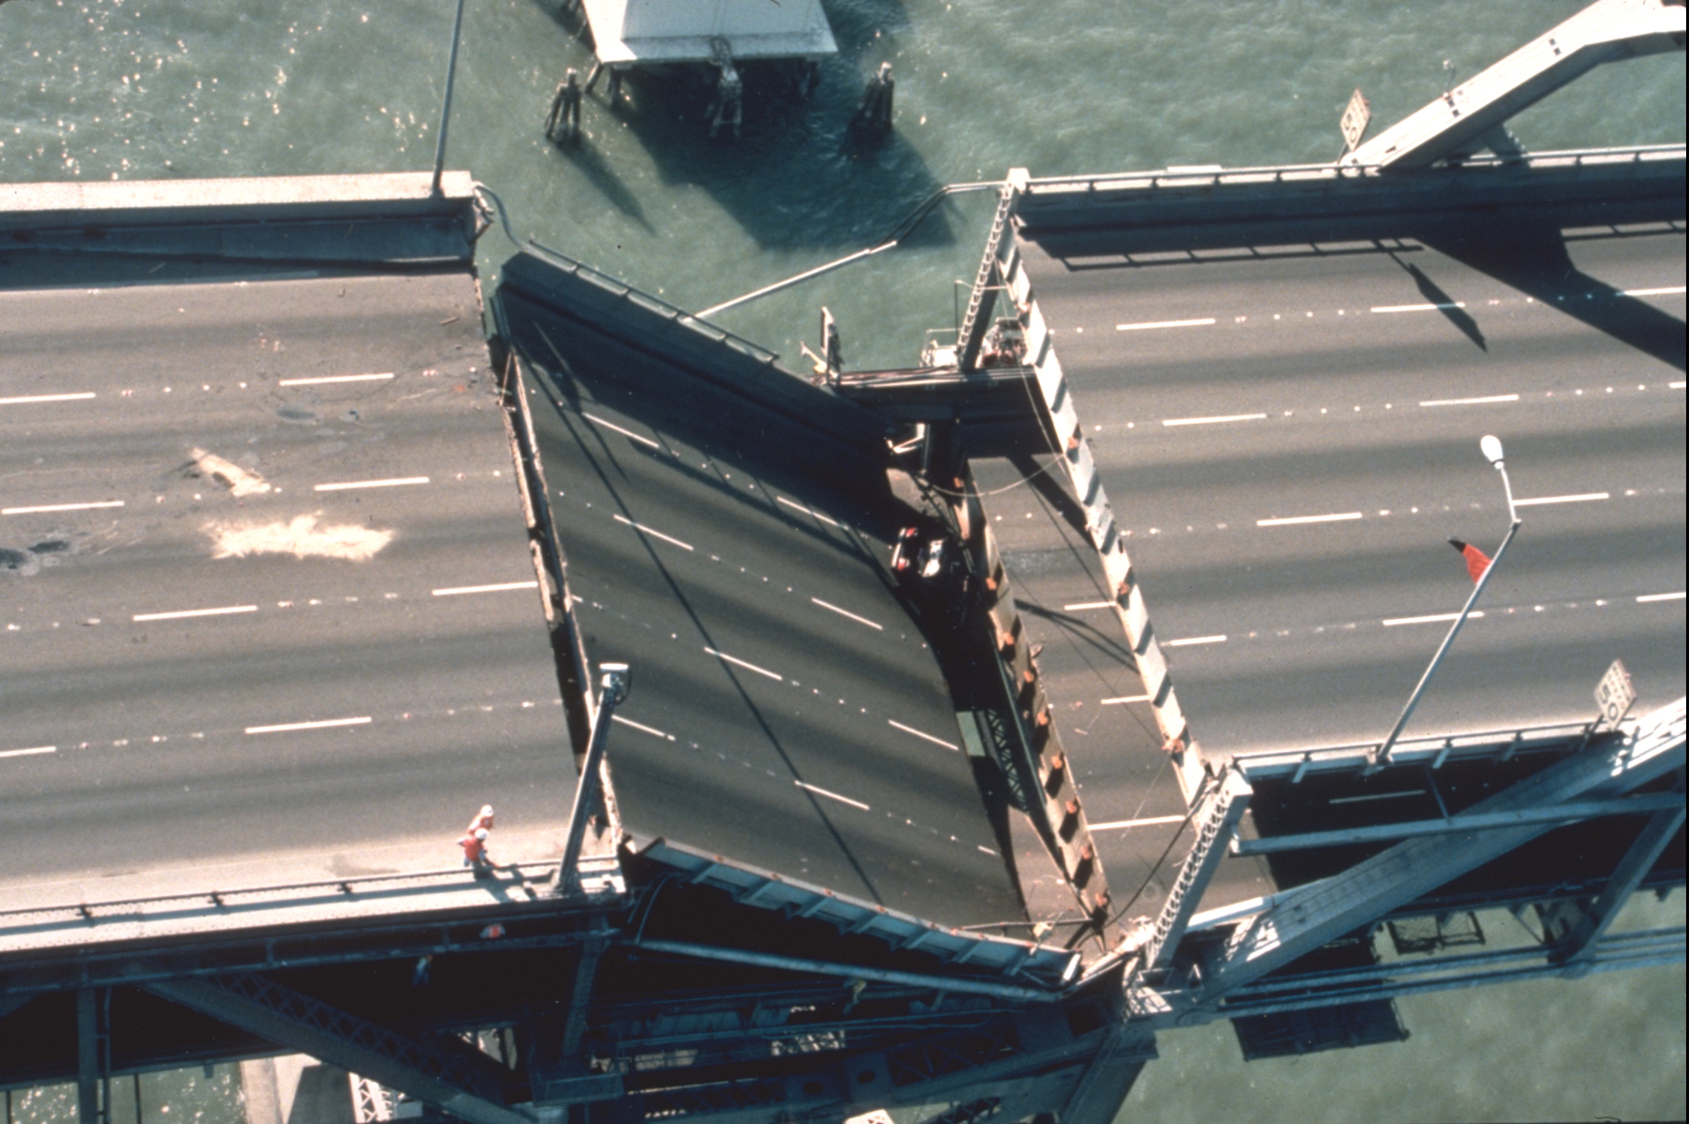
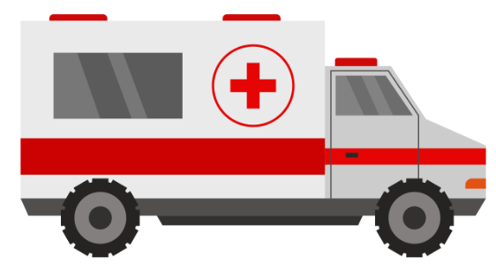
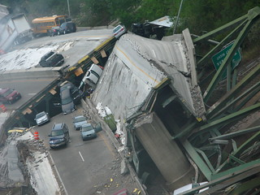
Know the reality
The services you rely on will be significantly disrupted.
First responders may not be able to help you for some time

Slide 12
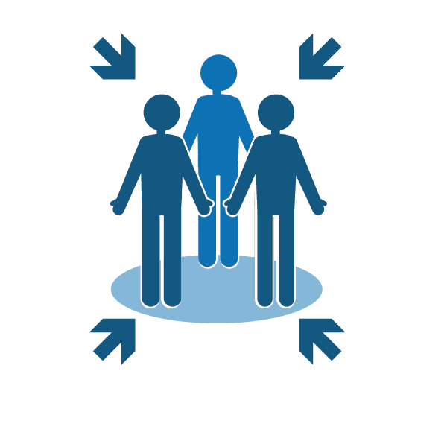

Develop a plan
Consider the following:
How will you reunite with family?
Know alternate routes home and to work
Know plans for work and children’s schools or day care
What if you have no electricity?
What if you have no water service?

Slide 13
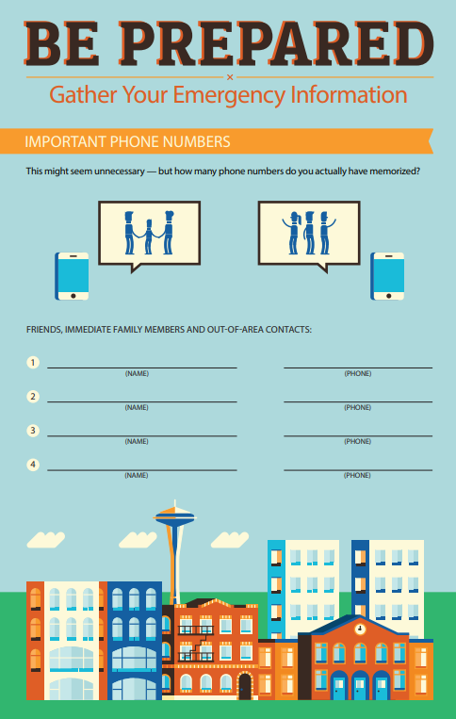
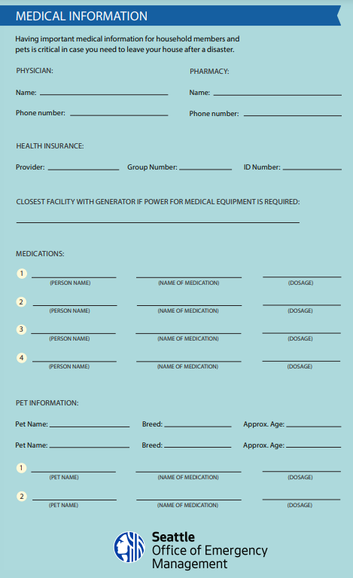
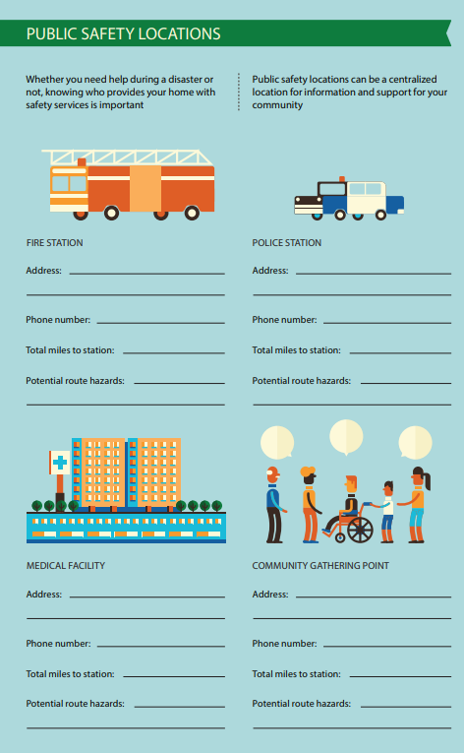
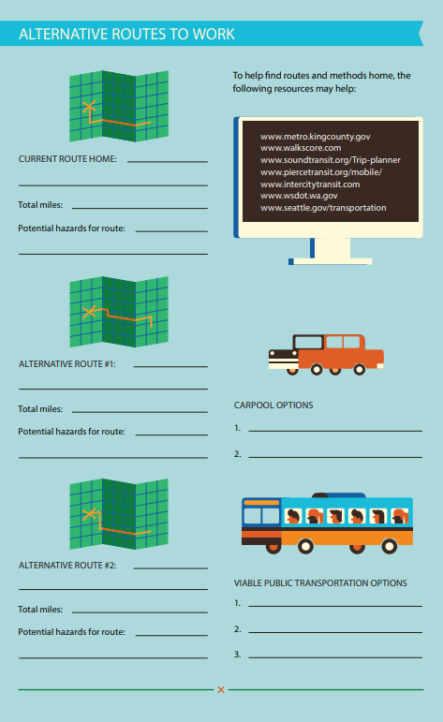
http://www.seattle.gov/Documents/Departments/Emergency/Be%20Prepared%20Infographic/OEM%20Be%20Prepared%20Insert(0).pdf

Slide 14
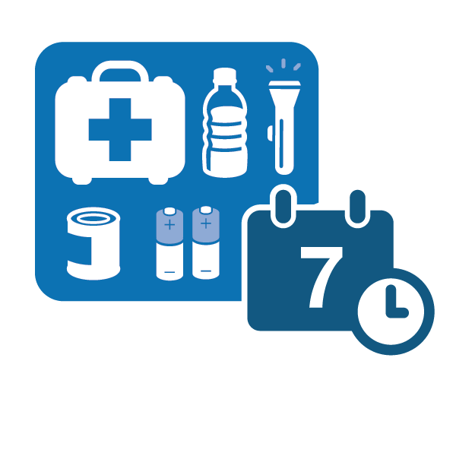
Build a Kit
Be prepared to be on your own for 14 days.
Think about what you use on a daily basis, and include those items in your kit
Have a kit in your car and at work

Slide 15

Create a checklist:
Food for 14 days per person
Water for 14 days per person
Food for pets
Water for pets
Medicine
Flashlight
Batteries
Blankets and extra clothing
Sleeping bags/tent
Battery operated radio
Family Plan of Action
Important Documents (Insurance/medical)
Something you enjoy!
This Photo by Unknown Author is licensed under CC BY-NC

Slide 16
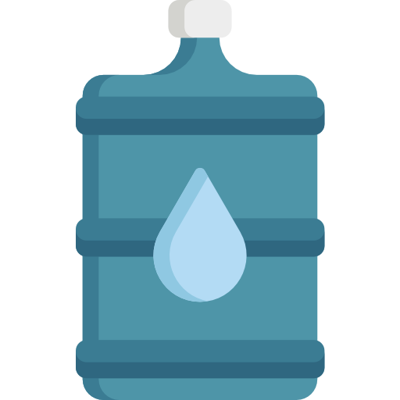
Know where to find water and how much
Sources of water
Hot water heater
Back of toilet tank
Filling tub with water in advance of a storm
Locate nearest water source and purify
How much water do you need?
1 gallon / person / day

Slide 17
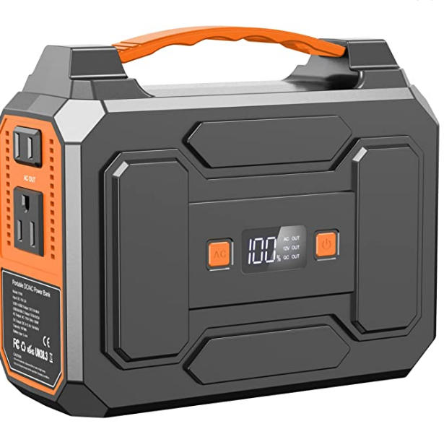
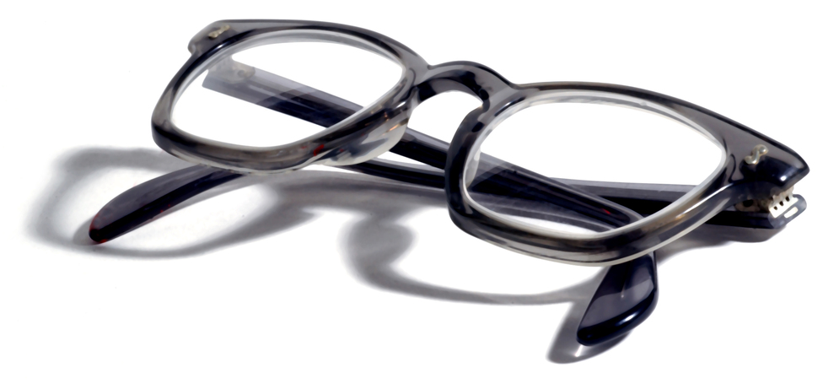
Medicine and Medical Equipment
Keep at least 30 days of medical supplies
Extra assistive items (walkers, canes, eyeglasses)
Food Specific, dietary needs
Power supply for medical equipment (battery power or electricity)

Slide 18

Communications Plan
Include the following in your communications plan:
Texting is your best option
Establish text message groups
Social media
Don’t make calls unless absolutely necessary

Slide 19
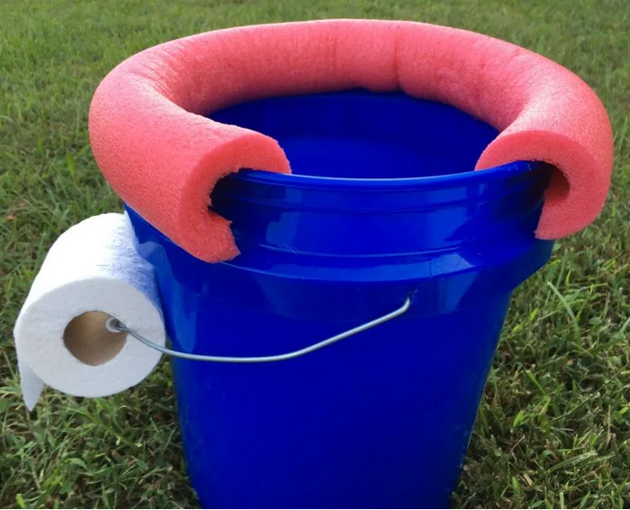
Emergency Sanitation
Following a major disaster, water and sewer lines may be disrupted. Do you know how to improvise an emergency toilet?
Supplies:
2 Plastic buckets with lids
Heavy duty garbage bags and ties
Absorbent material like cat litter or shredded newspaper
Household bleach
Soap
Rubber gloves
Toilet paper
Antiseptic towelettes
Hand sanitizer

Slide 20
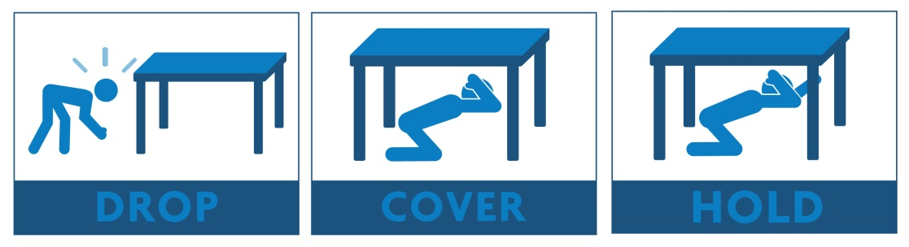

What to do during an earthquake
Don’t run during the shaking
Drop, Cover, and Hold under a desk or table
If there’s no table, find the nearest safe place beside an inside wall.
If outside in an open area, sit down and cover your head with your arms
If in the ‘danger zone’ next to a building, try to get back into the building and find shelter.

Slide 21
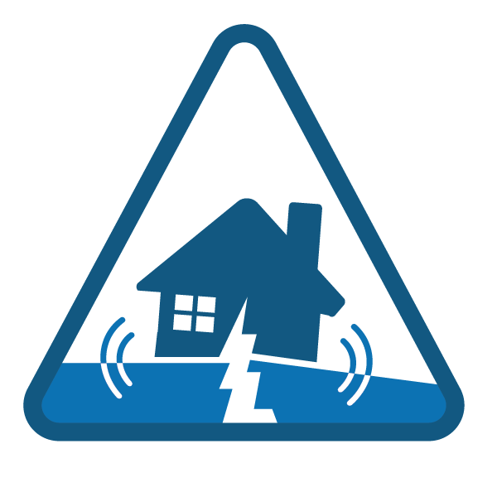
What to do after an earthquake
Check on yourself and your family for injuries
Check on your home
Check on others
Find out more information

Slide 22
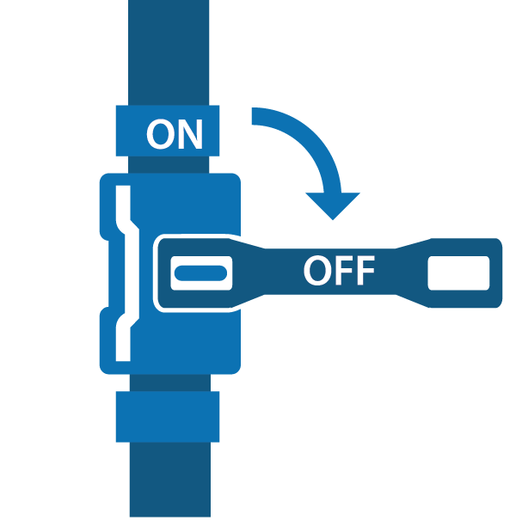
Know how and when to control utilities
Shut off natural gas ONLY if necessary
Only shut it off if you smell natural gas, hear a hissing sound, or the dial is spinning rapidly
Shut off water at the main house valve
Typically located right outside your house or inside
This saves the water in your hot water heater and toilet from possible contamination
Turn off power to the water heater- attach a hose
Check to see if your home sustained structural damage
Rope off damaged areas so others know how

Slide 23
Insurance and Government Assistance
Do not rely on FEMA or other government assistance as your insurance plan
  Usually no more than $37,900 for a total loss
  Small Business Administration (SBA) Loans vs. Individual Assistance Program (IAP)
Homeowner’s Insurance vs. Renter’s Insurance
Know what your insurance covers and what it does not
  Earthquake – can be added on or purchased separately
  Flood – must be purchased separately through the NFIP
    Rising water vs. Falling water

Slide 24
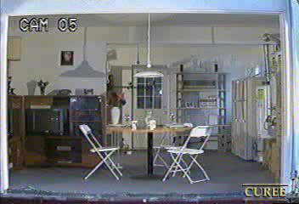
Home Hazard Mitigation and Retrofitting
Secure the following:
Large furniture
Wall hangings
Kitchen cabinets & contents
Water heater
Washer/Dryer
Stoves
Hazardous Materials
Go on a 30-minute home hazard hunt.
Attend a free home retrofit class.
Visit seattle.gov/emergency to register on our events calendar.
Retrofit your home
See a list of contractors on OEM’s website.

Slide 25
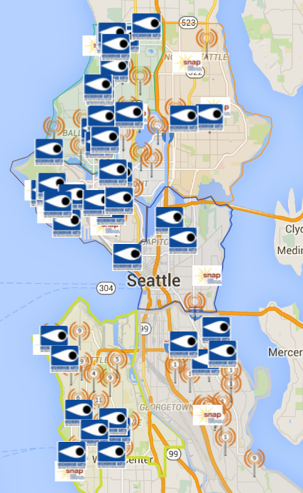


Know your neighborhood’s plan
Help each other
Community Emergency Hubs
seattleemergencyhubs.org
http://seattleemergencyhubs.org/
Seattle Neighborhoods Actively Prepare

Slide 26

Sign up for emergency alerts
You can choose to receive Emergency Alerts or Community Notifications, such as:
Severe weather
Safety
Health
Special events
Utility disruptions
Major traffic disruptions
Emergency preparedness
Test messages
When emergencies happen, be the first to know. Stay informed with AlertSeattle to receive real-time, official notifications from the City of Seattle. This is a free service.
alert.seattle.gov

Slide 27
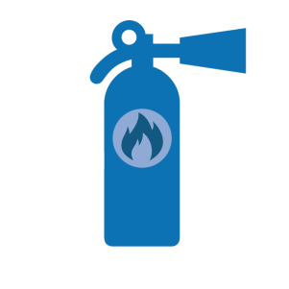
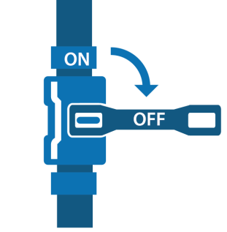

Disaster skills training
Learn how to use a fire extinguisher
Check on and control utilities
  Shut off water at the main house valve
  Shut off natural gas ONLY if necessary
Construct an emergency toilet
Stop the Bleed
Sign up for classes at www.seattle.gov/emergency

Slide 28





Find out more information
Get AlertSeattle and Alert King County messages
  Sign up online at alert.seattle.gov
Tune into local emergency radio stations
  AM 710, AM 1000, FM 97.3, FM 97.7, and FM 94.4
Tune into local television
Follow city departments on social media
  @CityofSeattle, @oemseattle, @SeattlePD, @SeattleFire, @AlertSeattle, @SeattleDOT, @SeattleSPU, @SEAcitylight
Go to your nearest Community Emergency Hub

Slide 29

Questions?
Thank you for attending- you’ll be happy you prepared ahead of time when the next disaster strikes!

Slide 30
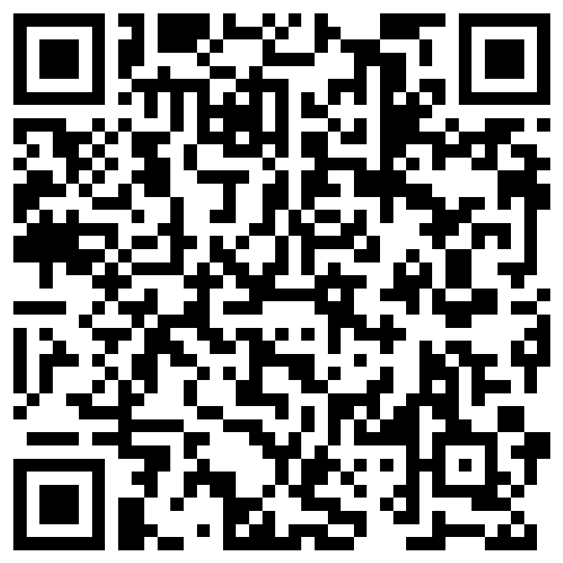
Please tell us how we did!
Thank you!
https://forms.office.com/g/9XALDPkKtj

